Slide 1
Campaign Finance

Slide 2
hard money
money donated directly to a candidate
Regulated by the FEC (Federal Election Commission)
Individuals can give $2,700 to a candidate or $33,400 to a party
Money can be used however the party or candidate wants
Donors are disclosed to the FEC
Notes:
Raising such limited funds is harder than raising unlimited funds, hence the term “hard money.”

Slide 3
soft money
a contribution given to political parties for “party building activities”
Since the Bipartisan Campaign Finance Reform Act (aka the McCain Feingold Act or BCRA)was passed in 2002, soft money contributions for federal elections are prohibited
Notes:
Unlimited funds obtained by political parties that are spent on party activities such as get-out-the-vote drives, but not on behalf of a specific candidate.
Now largely illegal except for limited contributions to state or local parties for voter registration and get-out-the-vote efforts.

Slide 4
independent expenditure
The Supreme Court has ruled that individuals, groups, and parties can spend unlimited amounts in campaigns for or against candidates as long as they operate independently from the candidates.
When an individual, group, or party does so, they are making an independent expenditure.

Slide 5
Political Action Committees (PACs)
funding vehicles organized by interest groups, corporations, or unions which pool contributions from members or employees to give to candidates or parties (hard money)
Regulated by the FEC
PACs can give $5,000 to a candidate and $15,000 to a party
Money can be spent however the party or candidate wants
Donors are disclosed to the FEC
Notes:
The “money arm” of Interest Groups
Corporations cannot contribute directly to PACs but can sponsor a PAC for employee donations

Slide 6
Super PACs
Newest kind of PAC that pays for political communications (ads)
CAN advocate for or against a candidate by name
CANNOT be coordinated with parties or candidates
Regulated by the FEC
CANNOT give money to a candidate; CANNOT coordinate with parties or candidates
No limits on how money can be spent
Donations disclosed to the FEC
Notes:
Independent expenditure

Slide 7
527 Groups
Non-profit, tax exempt groups that raise unlimited funds from individuals, corporations, and unions
Run issue ads
Cannot use magic words
Regulated by the Internal Revenue Service (IRS)
CANNOT give to a candidate or to a party and CANNOT coordinate with parties or candidates
Can only spend money on issue ads
Donations are disclosed to the IRS, not the FEC
Notes:
Independent expenditure
527s can give as much as they want to promote their views but cannot coordinate with a candidate/campaign
Because of their tax exemption status, they cannot expressly advocate for a candidate
Named after Section 527 of the Tax Code

Slide 8
501(c)4s
Non-profit, tax exempt groups that can engage in varying amounts of political activity, BUT it cannot be their main function
Run issue ads
Cannot use magic words
Regulated by the IRS
CANNOT give to a candidate or to a party and CANNOT coordinate with parties or candidates
For the most part, donors are NOT disclosed (dark money)
Notes:
Independent expenditure
key difference:
Super PACs must disclose their donors while 501(c)(4)s do not.
If you are a donor looking to influence election but do not want to reveal your identity, the 501(c)(4) is an attractive option through which to send your cash.
Cannot spend more than ½ of its money on political activities

Slide 9
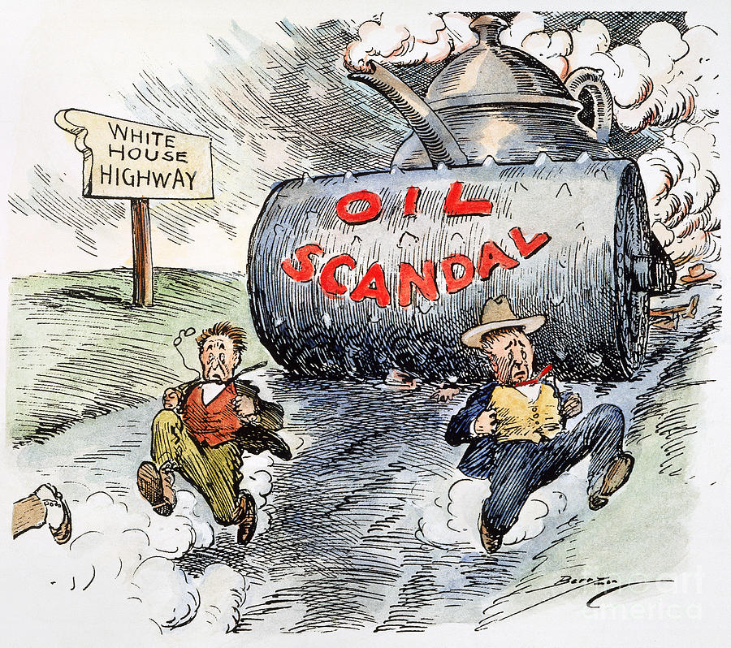
History of Money & Politics
The Teapot Dome Scandal (1920s)
Albert Fall, a former Secretary of the Interior, was charged with accepting bribes from oil companies in exchange for exclusive rights to drill for oil on federal land.
The sites included land near a teapot-shaped outcrop in Wyoming known as Teapot Dome, and two other government-owned sites in California named Elk Hills and Buena Vista Hills.

Slide 10
Warren G. Harding

Slide 11
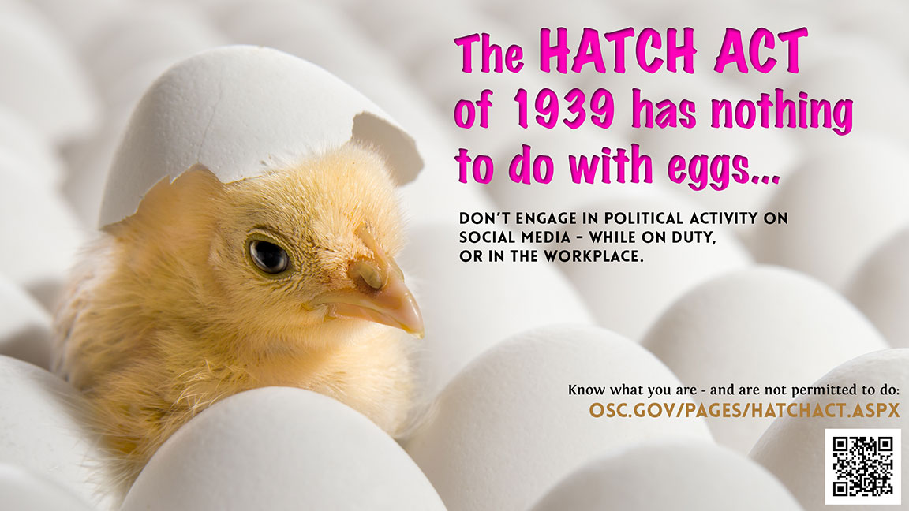
The Political Activities Act of 1939 (aka the Hatch Act)
law that seeks to keep government functions nonpartisan
it applies to federal employees as well as state and local employees who work with federally funded programs
the rule is a workplace guideline, and violating it is not a crime. Responses can vary significantly after employees violate the rule, from a slap on the wrist to loss of a job.

Slide 12
The Political Activities Act of 1939 (aka the Hatch Act)
forbids the intimidation or bribery of voters and restricts political campaign activities by federal employees.
It prohibits using any public funds designated for relief or public works for electoral purposes.
It forbids officials paid with federal funds from using promises of jobs, promotion, financial assistance, contracts, or any other benefit to coerce campaign contributions or political support.
It provides that persons below the policy-making level in the executive branch of the federal government must not only refrain from political practices that would be illegal for any citizen, but must abstain from "any active part" in political campaigns, (there are a few exemptions)
The act also precludes federal employees from membership in "any political organization which advocates the overthrow of our constitutional form of government”

Slide 13
The Federal Election Campaign Act of 1971 (aka FECA)
primary U.S. federal law that regulates political campaign spending and fundraising
originally focused on increased disclosure of contributions for federal campaigns
The law set limits on the amount of money an individual could contribute to a single campaign and it required reporting of contributions above a certain threshold amount. The Federal Election Commission was created to enforce the statute.
Limits on individual donations; illegal for corporations to donate

Slide 14
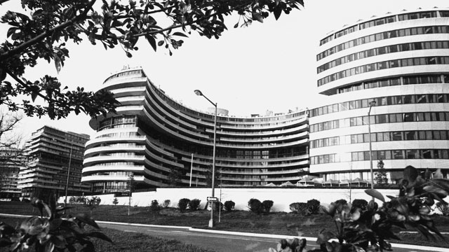
The Watergate Scandal (1974)
5 men broke into the DNC headquarters in the Watergate Hotel
The ensuing scandal
involved campaign finance
Notes:
Nixon resigned in August and was pardoned in September

Slide 15
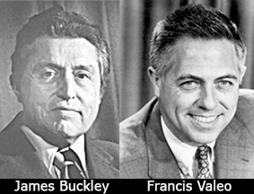
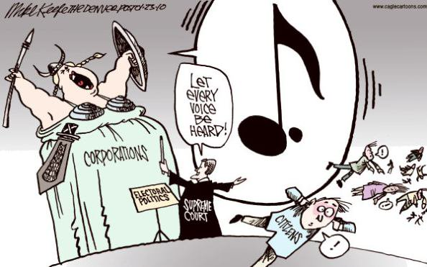
Buckley v. Valeo (1976)
Chief Justice
Amendment/clause involved
Background
How did the SC rule?
Significance

Slide 16
Excerpt from SC Opinion
Virtually every means of communicating ideas in today’s mass society requires the expenditure of money. The distribution of the humblest handbill or leaflet entails printing, paper, and circulation costs. Speeches and rallies generally necessitate hiring a hall and publicizing the event. The electorate’s increasing dependence on television, radio and other mass media for news and information has made these expensive modes of communication indispensable instruments of effective political speech.

Slide 17
Buckley v. Valeo (1976)
Aftermath of the Watergate scandal and legislation
Question: Can campaign finance money be limited?
7-2 Ruling: Campaign speech is free speech.
Upheld the law’s limit on individual donations and the $5,000 limit on PAC donations
Congress cannot limit a candidate’s donation to his or her own campaign, nor can it place a maximum on the overall receipts or expenditures for a federal campaign
Notes:
One of the earliest cases on campaign finance
Chief Justice: Burger
Valeo – Sec. of U.S. Senate
The first Amendment’s right to free speech complicates legislative efforts to try to get the money out of politics.
In the wake of the Watergate affair, Congress attempted to ferret out corruption in political campaigns by restricting financial contributions to candidates. Among other things, the law set limits on the amount of money an individual could contribute to a single campaign and it required reporting of contributions above a certain threshold amount. The Federal Election Commission was created to enforce the statute.
Did the limits placed on electoral expenditures by the Federal Election Campaign Act of 1971, and related provisions of the Internal Revenue Code of 1954, violate the First Amendment's freedom of speech and association clauses?
SC ruled in favor of
In this complicated case, the Court arrived at two important conclusions. First, it held that restrictions on individual contributions to political campaigns and candidates did not violate the First Amendment since the limitations of the FECA enhance the "integrity of our system of representative democracy" by guarding against unscrupulous practices. Second, the Court found that governmental restriction of independent expenditures in campaigns, the limitation on expenditures by candidates from their own personal or family resources, and the limitation on total campaign expenditures did violate the First Amendment. Since these practices do not necessarily enhance the potential for corruption that individual contributions to candidates do, the Court found that restricting them did not serve a government interest great enough to warrant a curtailment on free speech and association.

Slide 18
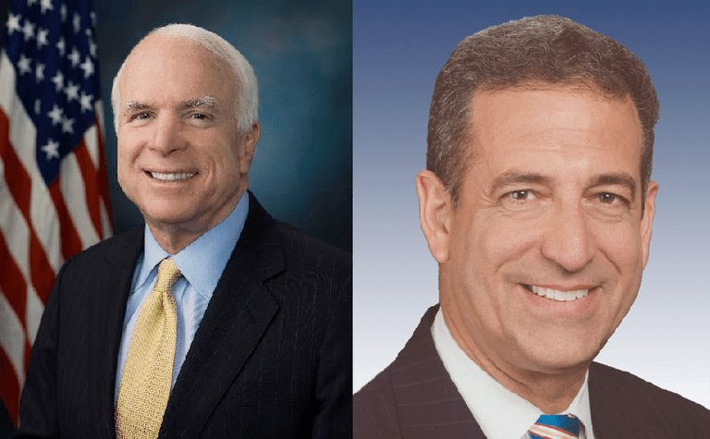
The Bipartisan Campaign Reform Act (abbreviated BCRA) (aka the McCain-Feingold Act)
In response to Enron scandal
AKA the McCain-Feingold Act
Banned nearly all soft money contributions
Increased individual contribution limits
Regulated some independent expenditure advertising
Notes:
The primary purpose of the Bipartisan Campaign Reform Act (BCRA) was to eliminate the increased use of so-called soft money to fund advertising by political parties on behalf of their candidates.
Prior to the law’senactment, money was considered “hard” if it was raised in accordance with the limits concerning sources and amounts specified by FECA as amended in 1974. For example, individual contributions were limited to $1,000 per federal candidate (or candidate committee) per election, and contributions by corporations and unions were prohibited (a ban that had been in effect since the early 20th century). However, state campaign finance rules differed from federal rules, as states allowed corporations and unions to donate to state parties and candidates in large, sometimes unlimited, amounts. Such soft-money contributions could then be funneled to federal candidates and national party committees, thus circumventing the FECA limits. That practice was particularly apparent in the U.S. presidential elections of 1996 and 2000.

Slide 19
Under the BCRA . . .
Corporations and unions could not spend their own money on campaigns → instead, they could set up PACs, and employees or members could donate to the PAC . . .
The law prohibited corporations and unions from directly paying for advertisements that supported or denounced a specific candidate within 30 days of a primary election or 60 days of a general election

Slide 20
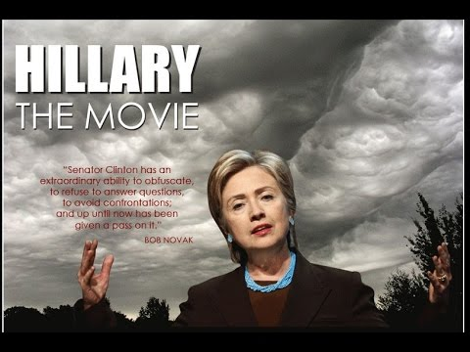
What was Citizens United and why did they sue the FEC?
Notes:
CU – a nonprofit organization funded partially by corporate donations
CU produced a film called Hillary: The Movie → a movie created to persuade voters not to vote for Hillary Clinton as the 2008 Democratic presidential nominee. They wanted to make the movie available to people on demand, and they wanted to broadcast TV ads for the movie in advance.
The FEC said that the movie was intended to influence voters – so the part of BCRA applied to this situation. So CU was NOT allowed to advertise the film, OR pay to air it within 30 days of the primary election.
CU sued the FEC in federal court – asking to be allowed to show the film.
The district court heard the case and decided that even though it was a full length movie, and not a traditional TV ad, it was definitely an appeal to vote against Hillary Clinton. Corporations and organizations could not pay to air this sort of direct appeal to voters so close to an election.
CU appealed directly to the Supreme Court.
The court had to consider whether the film fell under the umbrella of the BCRA and to decide whether the law violated CU’s 1st Amendment rights to engage in political speech. They agreed to hear the case – the oral argument took place in March of 2009. The court asked both sides to submit a written response to the question. They held a second oral argument on September 2009.

Slide 21
Does a law that limits the ability of corporations and labor unions to spend their own money to influence elections violate the First Amendment’s guarantee of free speech?

Slide 22
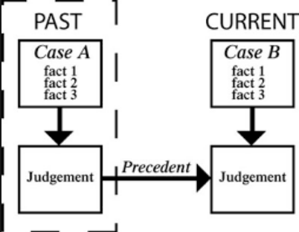
The Law & Precedents
Austin v. Michigan Chamber of Commerce (1990)
The BCRA is passed in 2002
Wisconsin Right to Life v. FEC (2007)

Slide 23
Arguments of each side

Slide 24
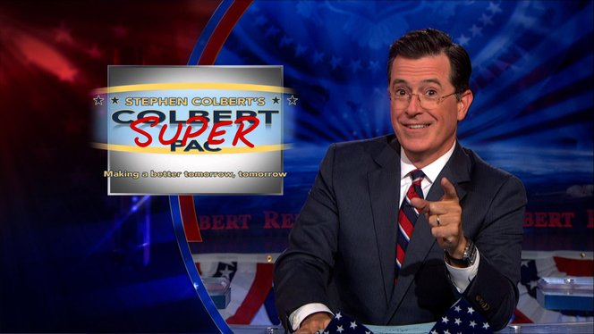
Super PACs in 2016
2,200 of them – raised more than $700 million
Example:
Pro-Hillary Super PAC: Priorities USA Action
Spent nearly $150 million on pro-Clinton and ant—Trump campaigning
Pro-Trump Super PAC: Make America Number 1
Spent nearly $20 million
Notes:
This series of clips was a sincere effort by Colbert to educate Americans about SuperPACs following the Citizens United decision. Go to the website and type "Trevor Potter" in the search box. Potter was an FEC chairman and plays the straight man to Colbert in explaining technical campaign finance law. Highly recommended.
Viewers of “The Colbert Report” who watched faux-conservative TV host Stephen Colbert set up a super PAC and 501(c)(4) organization during the last presidential election cycle proved to be better informed about campaign financing and the role of money in politics than viewers of other news channels and shows, according to a new study. (June 2014 article)
The study, published online in Mass Communication and Society, tested “The Colbert Report” against CNN, Fox News, MSNBC, and broadcast nightly news, as well as talk radio and newspapers as sources of political information. The study, “Stephen Colbert’s Civics Lesson,” was based on phone survey data from 1,232 adults 18 years or older who were interviewed between Dec. 13, 2012 and Dec. 23, 2012.
He walked us through creating a super PAC and every episode was a continuation of that story.

